Slide 1
gwiddle
https://gwiddle.co.uk/register

Slide 2
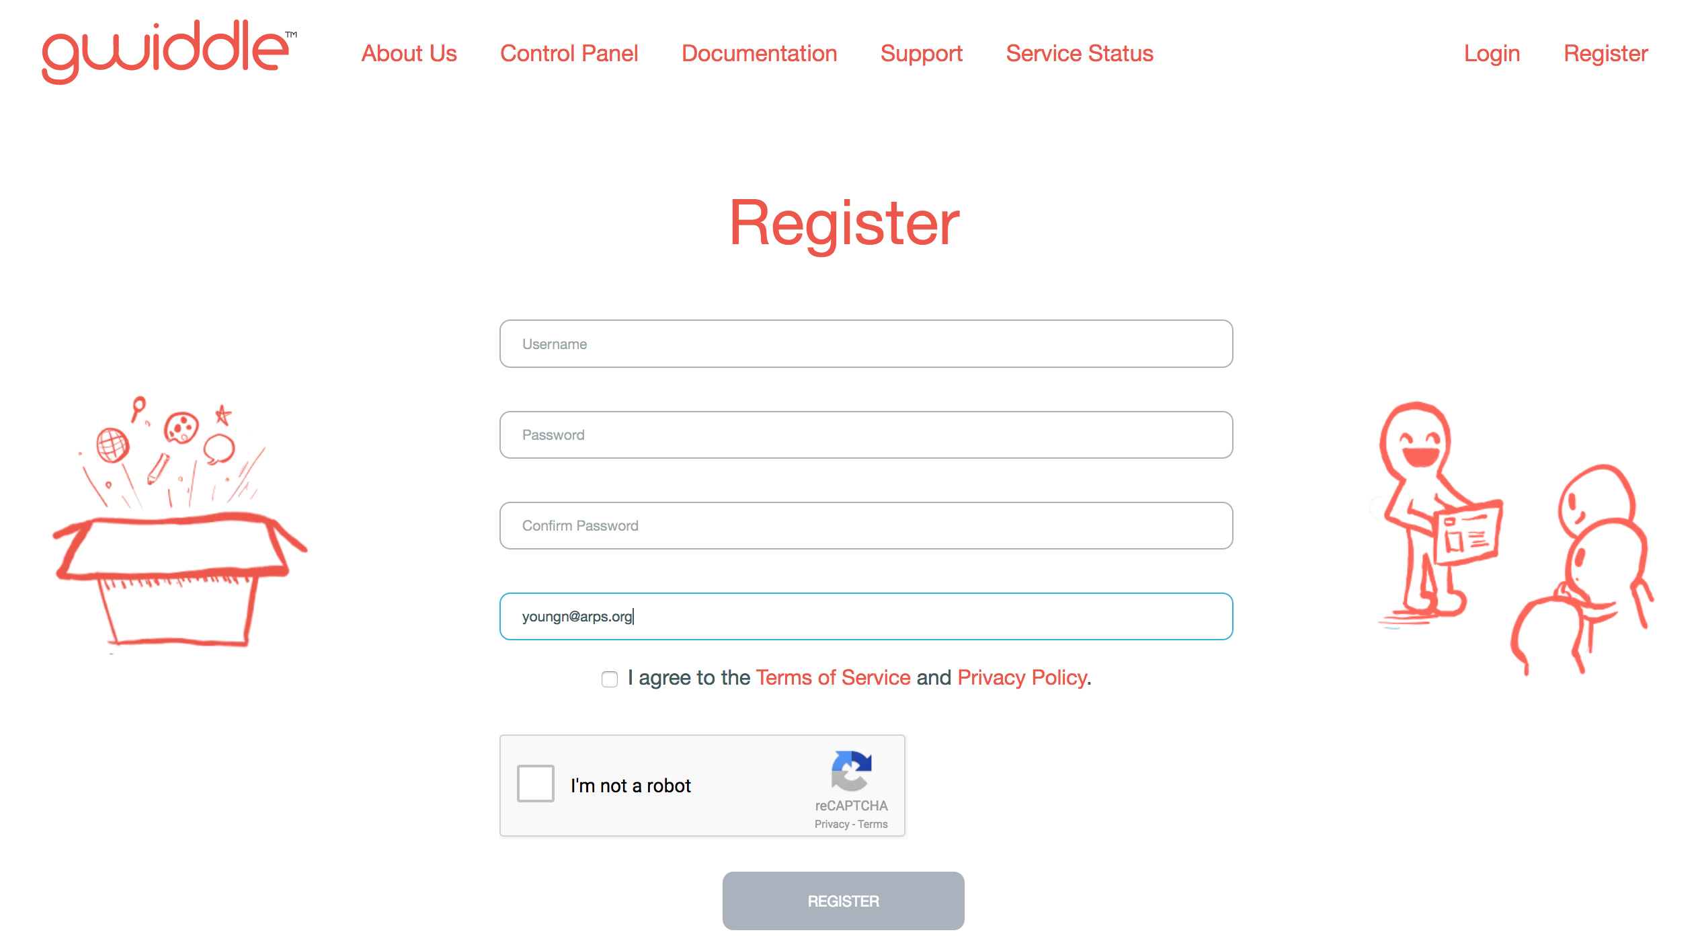
Register
Use your arps e-mail and it’s free

Slide 3


Slide 4


Slide 5
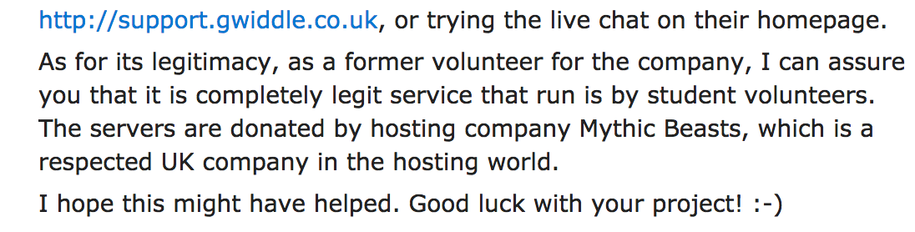

Slide 6


Slide 7
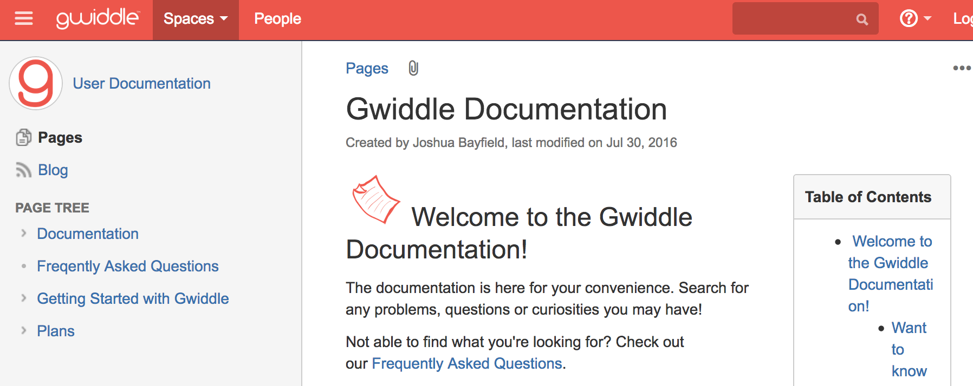

Slide 8
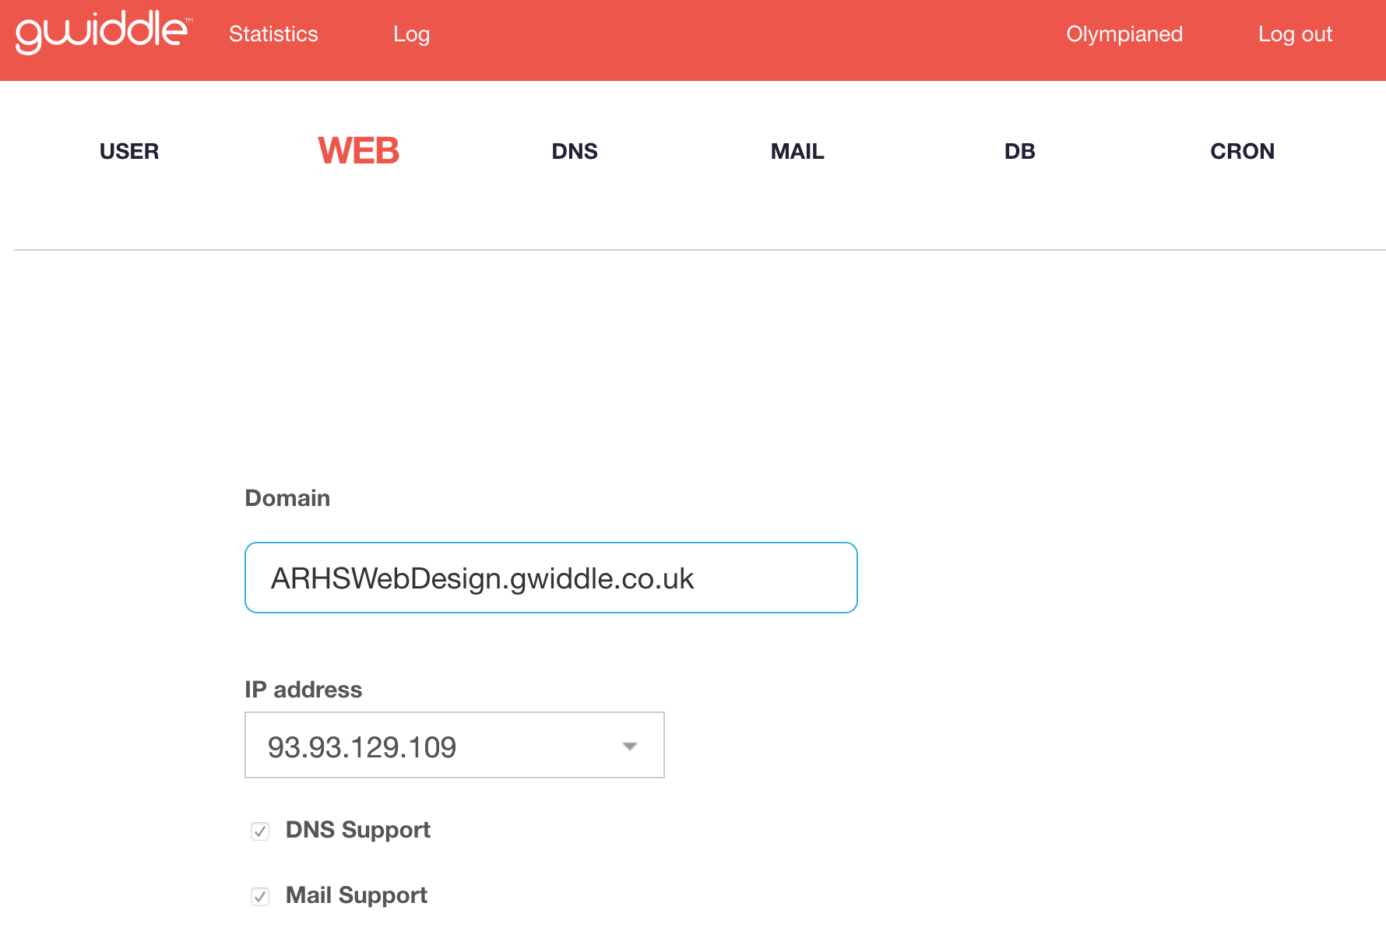

Slide 9
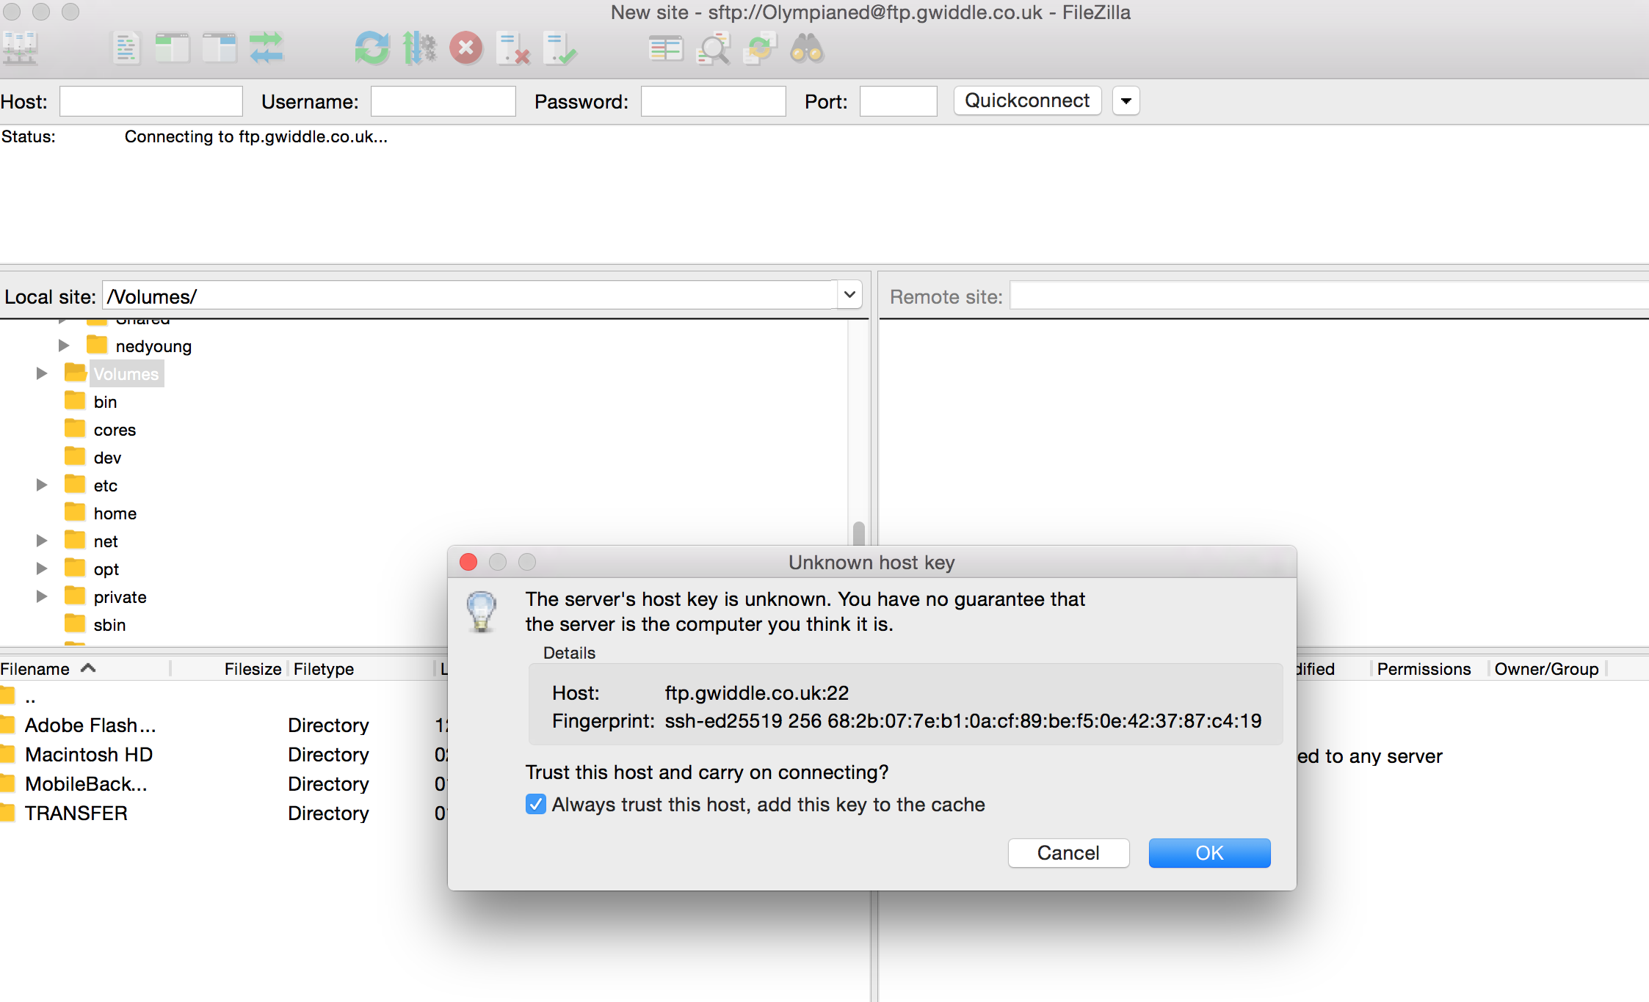

Slide 10
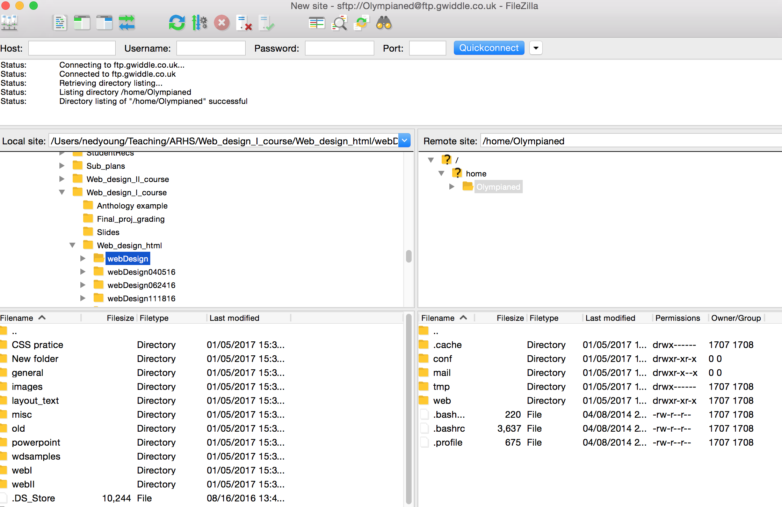

Slide 11
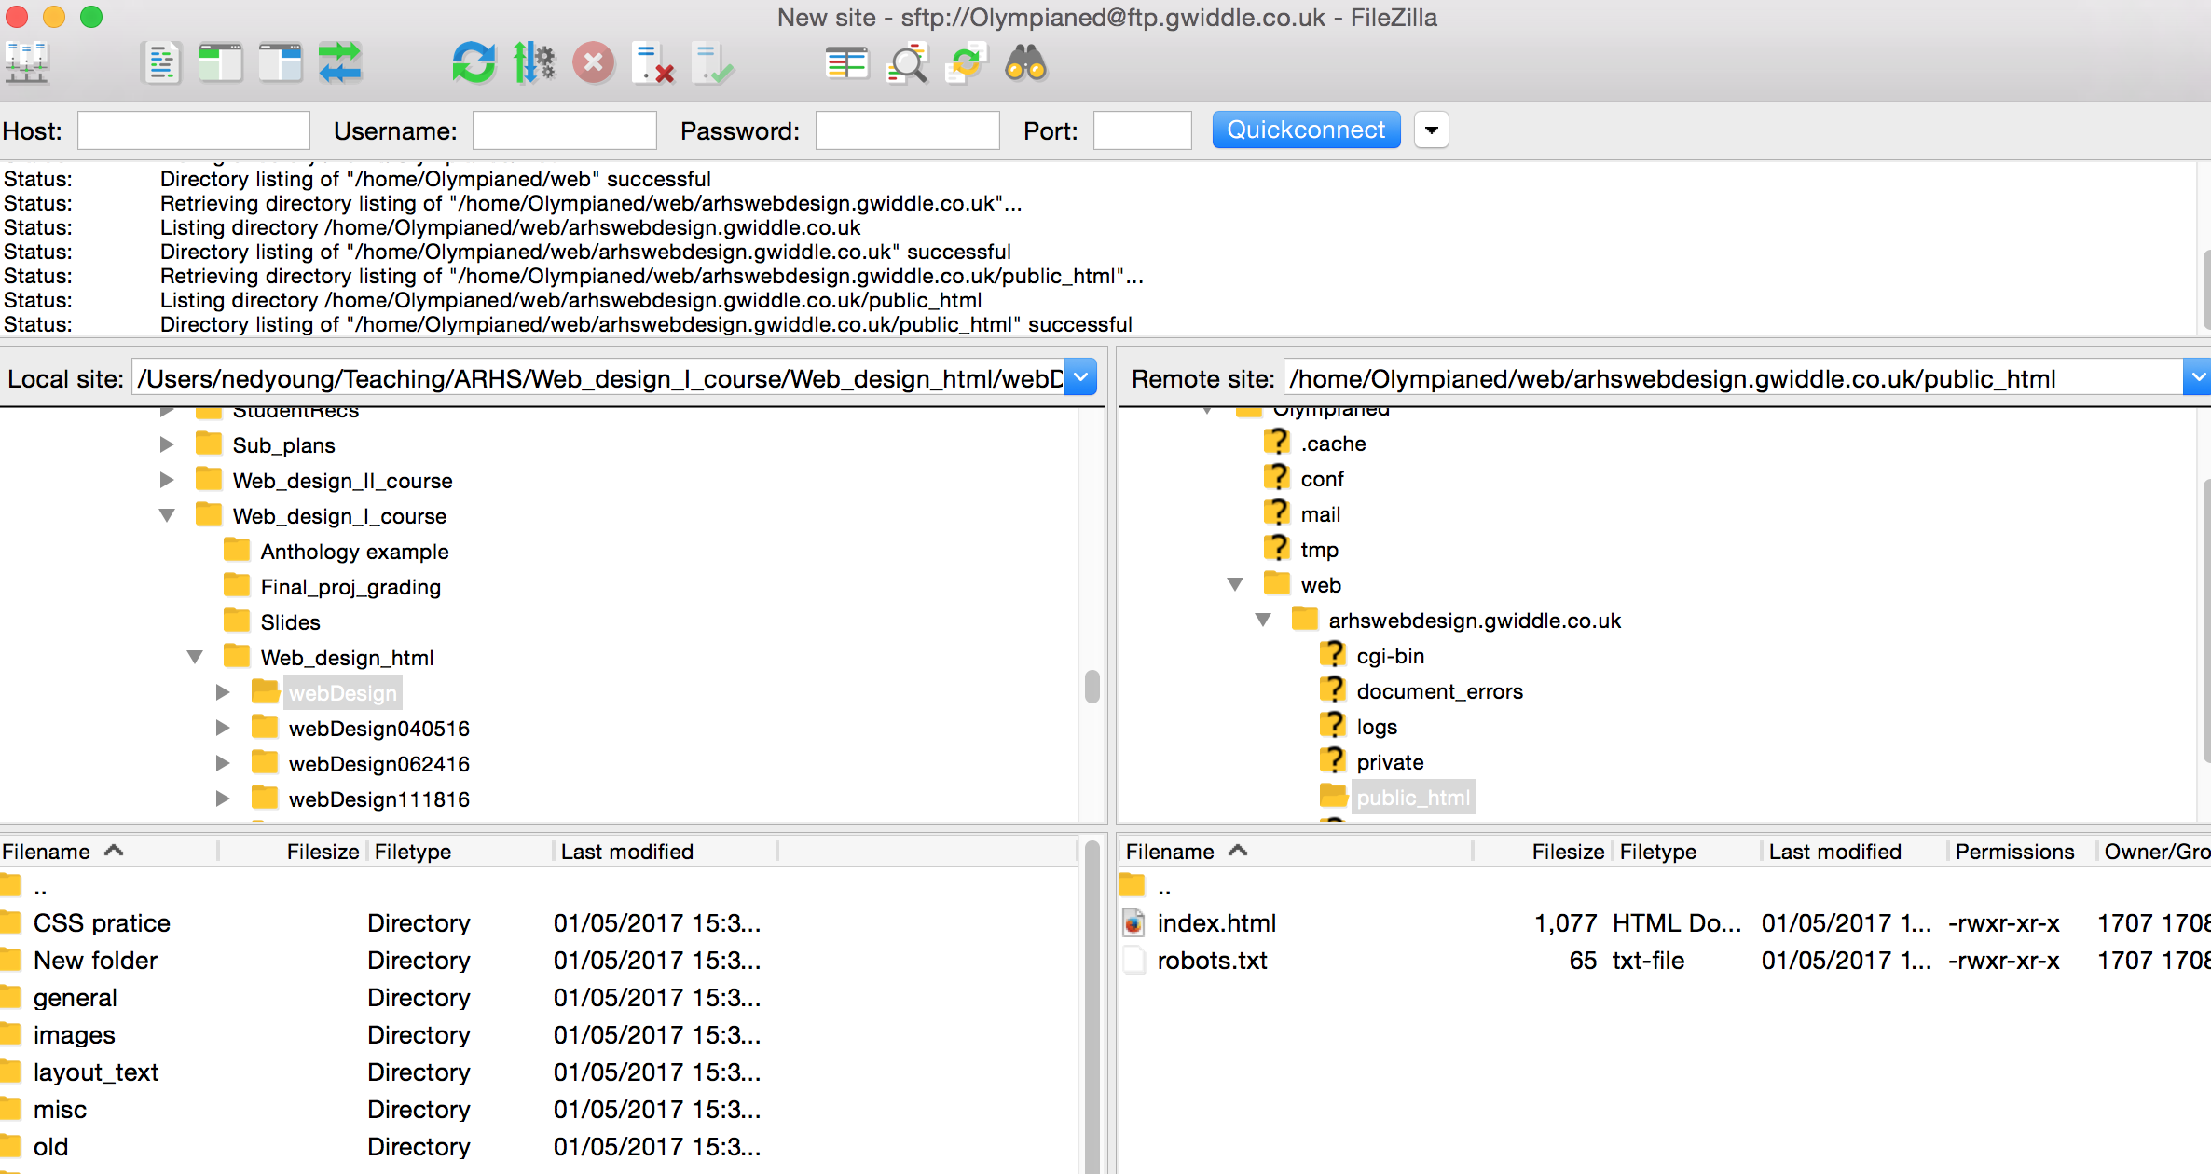

Slide 12


Slide 13
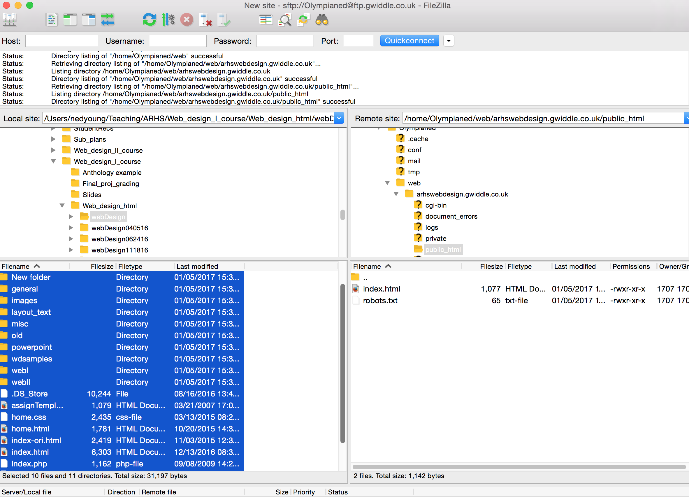

Slide 14
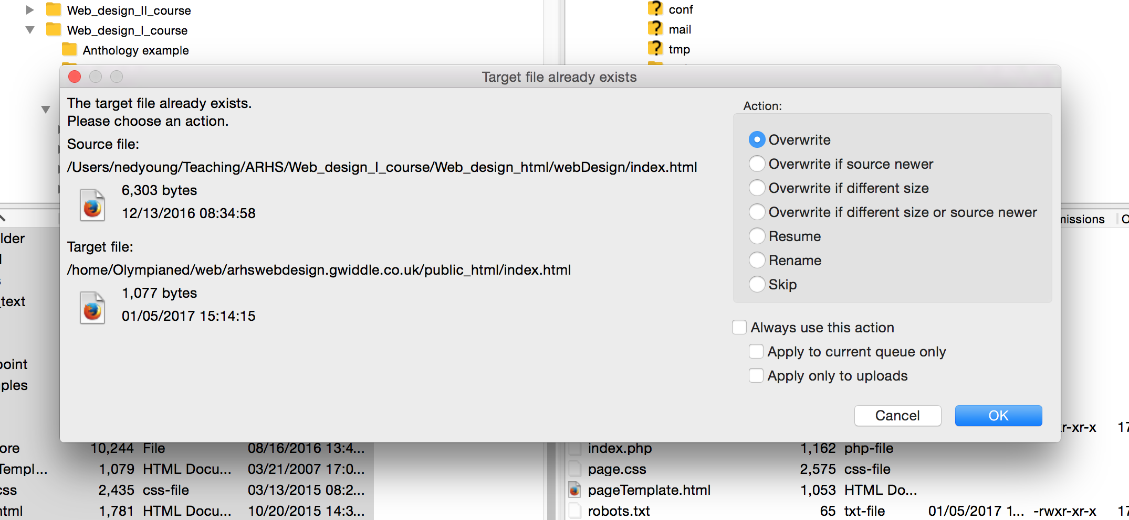

Slide 15
Wait 5 minutes

Slide 16


